Slide 1

Notes:
Myles Munroe, OBE was a Bahamian evangelist and ordained minister, professor, author, speaker and leadership consultant. He founded and led the Bahamas Faith Ministries International, and Myles Munroe International. - Wikipedia

Slide 2
Module 07: Discrete Random Variables & Probability Distributions

Slide 3
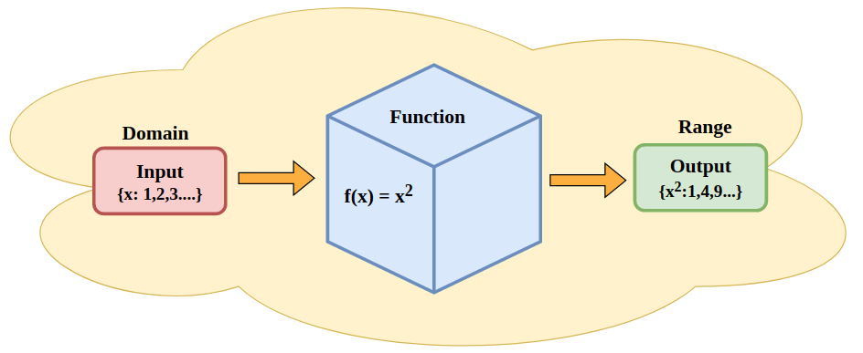
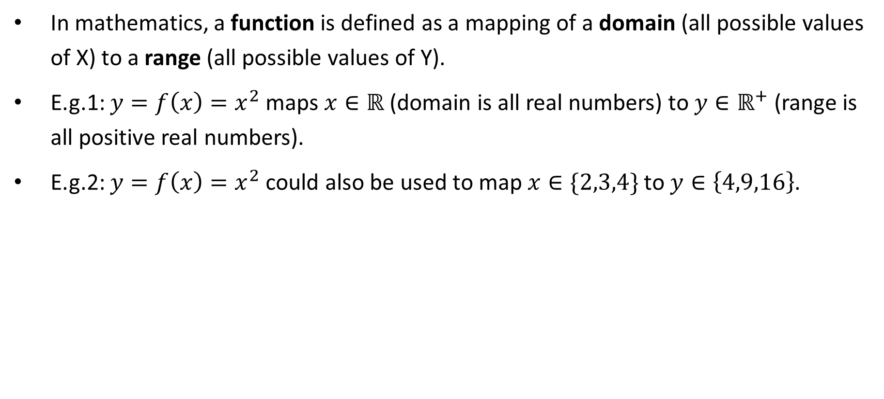
Review: Functions
In mathematics, a function is defined as a mapping of a domain (all possible values of X) to a range (all possible values of Y).
E.g.1: $y=f\left(x\right)=x^{2}$ maps $x∈ℝ$ (domain is all real numbers) to $y∈ℝ^{+}$ (range is all positive real numbers).
E.g.2: $y=f\left(x\right)=x^{2}$ could also be used to map $x∈\{2,3,4\}$ to $y∈\left\{4,9,16\right\}$.

Slide 4
Random Variables
In statistics, a random variable is a function mapping of all outcomes of an experiment (or sample space) to a set of “numbers”.
If there are finite or countably infinite “numbers”, then the random variable is a discrete random variable.
In this course, all discrete RV are whole numbers {0,1,2,3…} of counting numbers {1,2,3…}.
E.g.1: Expt = toss 3 coins, RV = number of heads Expt = roll 2 dice, RV = sum of dots
Otherwise, if there are infinite “numbers”, then the random variable is a continuous random variable. (More about this in the next slide deck.)
E.g.2: Expt = a social media post, RV = duration or length (in seconds) Expt = a person, RV = height (in centimetres) or weight (in kilograms)

Slide 5
Discrete Random Variables
E.g.1: (Empirical) During the first year of operation, customers at a local coffee shop order small coffee 30% of the time, medium coffee 50% of the time and large coffee 20% of the time. The owner will make a profit of $1.50, $1.20, and $0.80 from the sales of small, medium, and large coffee. Identify the experiment, outcomes and RV.
Expt = a customer at this local coffee shop Outcomes = order small, medium, or large coffee RV = profit per customer (or per order of coffee) -> there are only 3 (or finite) outcomes
E.g.2: (Theoretical) Consider the number of heads you get (or face up) when tossing 3 fair coins. Identify the experiment, outcomes and RV.
Expt = tossing 3 coins Outcomes = {HHH, HHT, HTH, THH, TTH, THT, HTT, TTT} RV = number of heads -> there are only 4 (or finite) outcomes

Slide 6
Discrete Probability Distributions
E.g.1: During the first year of operation, customers at a local coffee shop order small coffee 30% of the time, medium coffee 50% of the time and large coffee 20% of the time. The owner will make a profit of $1.50, $1.20, and $0.80 from the sales of small, medium, and large coffee. Construct a probability distribution (table).
E.g.2: (Theoretical) Consider the number of heads you get (or face up) when tossing 3 fair coins. Construct a probability distribution (table).
RV or X | 1.50 | 1.20 | 0.80
Prob or p(x) | 0.30 | 0.50 | 0.20
RV or X | 0 | 1 | 2 | 3
Prob or p(x) | 1/8 | 3/8 | 3/8 | 1/8
Notes:
Q: Why p(x) instead f(x)?
A: In statistics, there are two different probability functions.
Probability mass function (or simply pmf) and p(x) is usually used to represent it. It’s primarily used for discrete random variables.
Probability density function (or simply pdf) and f(x) is used to represent it. It’s primarily used for continuous random variables.
Note: It’s mostly used to differentiate discrete random variables from continuous when the context might be ambiguous. Otherwise, the use of p(x) and f(x) in any formula is the same.

Slide 7
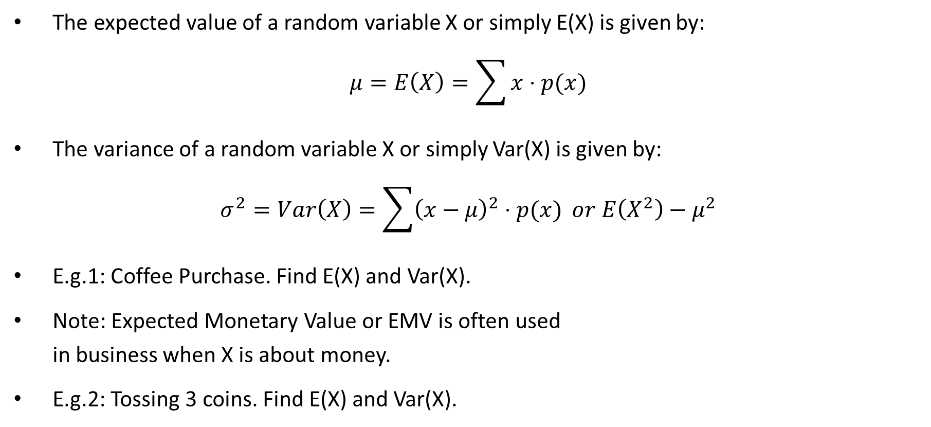
E(X) and Var(X)
The expected value of a random variable X or simply E(X) is given by:
$$μ=E\left(X\right)=\sum{x⋅p(x)}$$
The variance of a random variable X or simply Var(X) is given by:
$$σ^{2}=Var\left(X\right)=\sum{{\left(x−μ\right)}^{2}⋅p(x)} or E\left(X^{2}\right)−μ^{2}$$
E.g.1: Coffee Purchase. Find E(X) and Var(X).
Note: Expected Monetary Value or EMV is often used in business when X is about money.
E.g.2: Tossing 3 coins. Find E(X) and Var(X).
X | 1.50 | 1.20 | 0.80
p(x) | 0.30 | 0.50 | 0.20
X | 0 | 1 | 2 | 3
p(x) | 1/8 | 3/8 | 3/8 | 1/8
Notes:
Eg1:
E(X) = 1.5*0.3 + 1.2*0.5 + 0.8*0.2 = 0.45 + 0.6 + 0.16 = 1.21
Var(X) = (1.5 – 1.21)^2*0.3 + (1.2 – 1.21)^2*0.5 + (0.8 – 1.21)^2*0.2 = 0.0589
Var(X) = E(X^2) - \mu^2 = [1.5^2*0.3 + 1.2^2*0.5 + 0.8^2*0.2] – (1.21)^2 = 0.0589
Eg2:
E(X) = 0*1/8 + 1*3/8 + 2*3/8 + 3*1/8 = 1.5
Var(X) = (0 – 1.5)^2*1/8 + (1 – 1.5)^2*3/8 + (2 – 1.5)^2*3/8 + (3 – 1.5)^2*1/8 = 0.75
Var(X) = E(X^2) - \mu^2 = [0^2*1/8 + 1^2*3/8 + 2^2*3/8 + 3^2*1/8] – (1.5)^2 = 0.75

Slide 8
Interpretation of E(X) and Var(X)
Expected value is basically a “weighted average”, if you consider p(x) as the weight.
Therefore, the interpretation is like mean, with a twist (because it involves probability).
Interpretation of E(X): (1) an average of the (2) random variable (3) when the experiment is repeated infinite number of times.
We typically want to know the interpretation of SD(X) more often than Var(X).
Interpretation of SD(X): (1) a typical deviation from the average of the (2) random variable (3) when the experiment is repeated infinite number of times.
Interpret E(X) in e.g.1 and SD(X) in e.g.2.
Notes:
Eg1:
E(X) = 1.21
Interpretation: The average profit per cup of coffee (or per customer) when the experiment of “customers buying coffee at this local coffee shop” is repeated infinite number of times.
Or more statistics version: The average profit per cup of coffee (or per customer) among all customers visiting this local coffee shop. (Note that it’s the same as the description of mu – population mean. Did you notice the notation mu is the same?)
Eg2:
Var(X) = 0.75 or SD(X) = 0.866
Interpretation of SD(X): The typical number of heads deviated from the mean of 1.5 when the experiment of “tossing a fair coin three times” is repeated infinite number of times.
Or more statistics version: The typical number of heads deviated from the mean of 1.5, given the probability theory of tossing 3 fair coins.

Slide 9
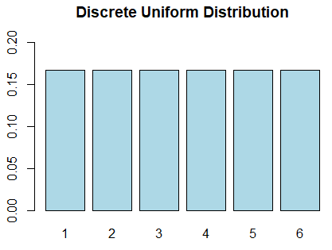

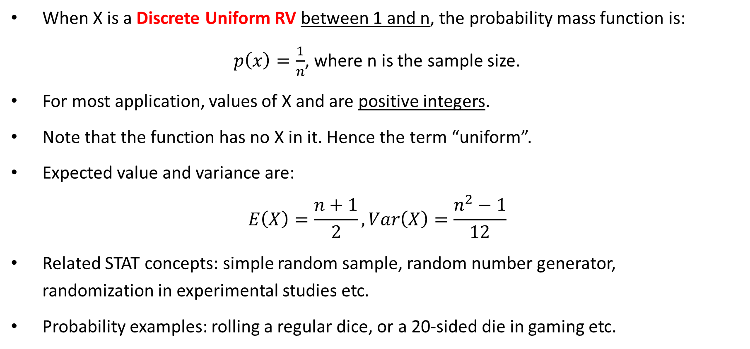
Discrete Uniform RV & Distributions
When X is a Discrete Uniform RV between 1 and n, the probability mass function is:
$p\left(x\right)=\frac{1}{n}$, where n is the sample size.
For most application, values of X and are positive integers.
Note that the function has no X in it. Hence the term “uniform”.
Expected value and variance are:
$$E\left(X\right)=\frac{n+1}{2}, Var\left(X\right)=\frac{n^{2}−1}{12}$$
Related STAT concepts: simple random sample, random number generator, randomization in experimental studies etc.
Probability examples: rolling a regular dice, or a 20-sided die in gaming etc.

Slide 10
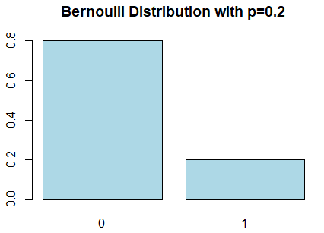
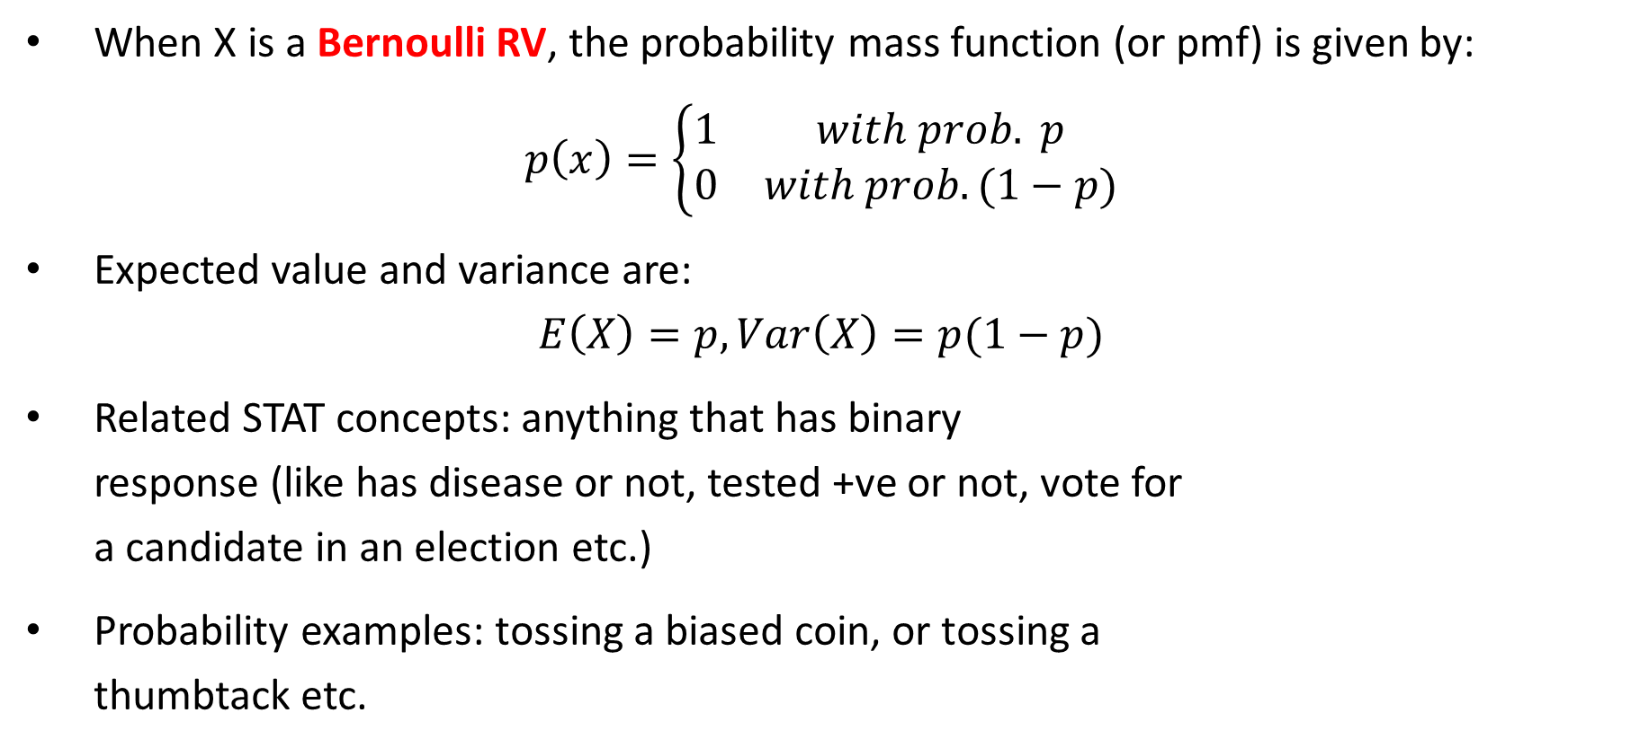
Bernoulli RV & Distributions
When X is a Bernoulli RV, the probability mass function (or pmf) is given by:
$$p\left(x\right)=\left\{\begin{matrix}1 & with prob. p \\ 0 & with prob. (1−p)\end{matrix}\right.$$
Expected value and variance are:
$$E\left(X\right)=p, Var\left(X\right)=p(1−p)$$
Related STAT concepts: anything that has binary response (like has disease or not, tested +ve or not, vote for a candidate in an election etc.)
Probability examples: tossing a biased coin, or tossing a thumbtack etc.
Notes:
Note: There are at least two prominent Bernoulli in the history of Science.
Jacob Bernoulli is the one credited with the creation of Bernoulli distribution. (https://en.wikipedia.org/wiki/Bernoulli_distribution)
Daniel Bernoulli is mostly known for his Bernoulli’s Principle in fluid dynamics application (in physics).
They are uncle and nephew. Both are Swiss.

Slide 11
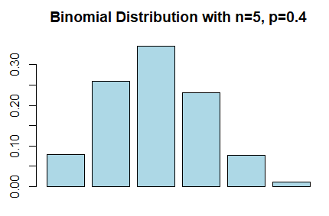
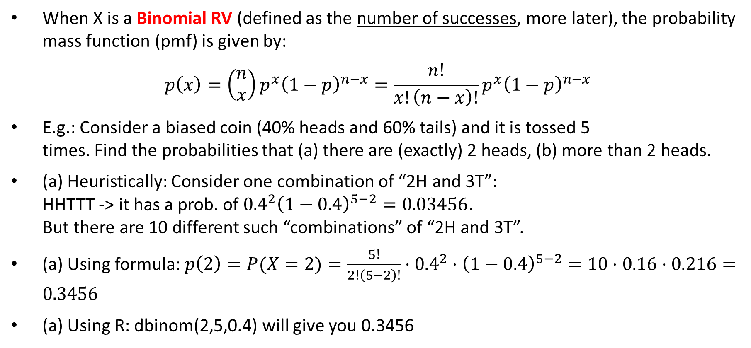
Binomial RV & Probability Calculations
When X is a Binomial RV (defined as the number of successes, more later), the probability mass function (pmf) is given by:
$$p\left(x\right)=\left(\begin{matrix}n \\ x\end{matrix}\right)p^{x}{\left(1−p\right)}^{n−x}=\frac{n!}{x!\left(n−x\right)!}p^{x}{\left(1−p\right)}^{n−x}$$
E.g.: Consider a biased coin (40% heads and 60% tails) and it is tossed 5 times. Find the probabilities that (a) there are (exactly) 2 heads, (b) more than 2 heads.
(a) Heuristically: Consider one combination of “2H and 3T”: HHTTT -> it has a prob. of ${0.4}^{2}{\left(1−0.4\right)}^{5−2}=0.03456$. But there are 10 different such “combinations” of “2H and 3T”.
(a) Using formula: $p\left(2\right)=P(X=2)=\frac{5!}{2!\left(5−2\right)!}⋅{0.4}^{2}⋅{\left(1−0.4\right)}^{5−2}=10⋅0.16⋅0.216=0.3456$
(a) Using R: dbinom(2,5,0.4) will give you 0.3456
Notes:
(a) Using Excel: =binom.dist(2,5,0.4,false) will give you 0.3456.
(b)
Using formula: P(X > 2) = p(3) + p(4) + p(5) or P(X > 2) = 1 – P(X <= 2) = 1 – [p(0) + p(1) + p(2)]
Using R: any of the following 3 functions will give you the same answer of 0.31744
sum(dbinom(3:5,5,0.4))
pbinom(2,5,0.4,FALSE)
1-pbinom(2,5,0.4)

Slide 12
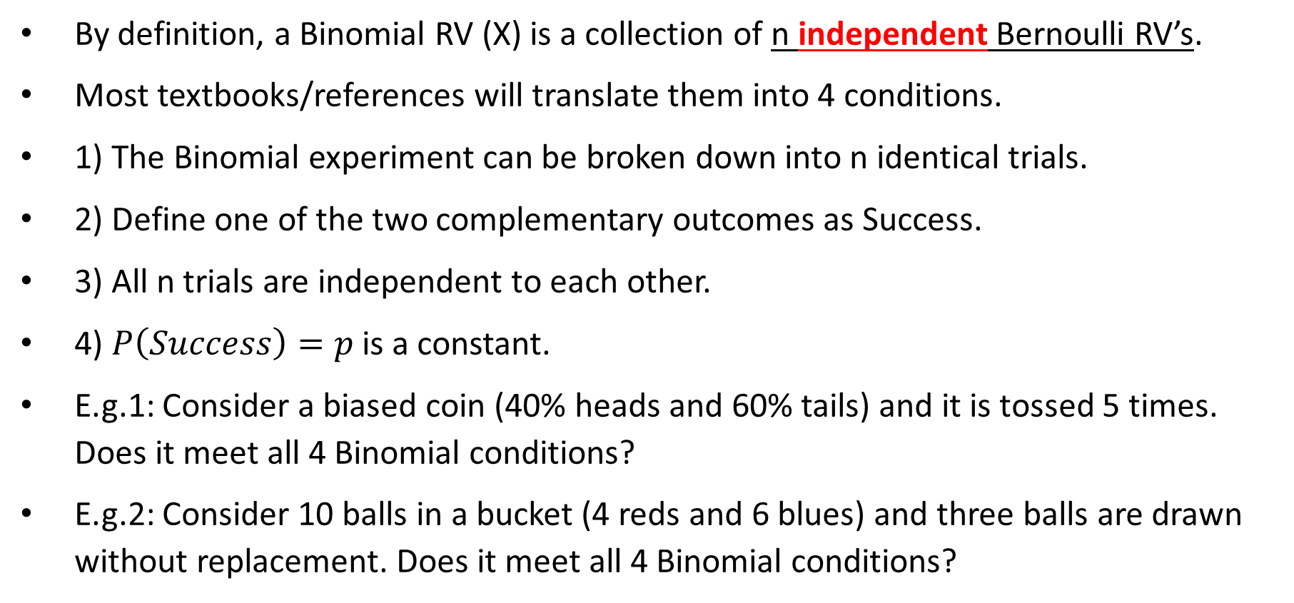
The 4 Binomial Conditions
By definition, a Binomial RV (X) is a collection of n independent Bernoulli RV’s.
Most textbooks/references will translate them into 4 conditions.
1) The Binomial experiment can be broken down into n identical trials.
2) Define one of the two complementary outcomes as Success.
3) All n trials are independent to each other.
4) $P\left(Success\right)=p$ is a constant.
E.g.1: Consider a biased coin (40% heads and 60% tails) and it is tossed 5 times. Does it meet all 4 Binomial conditions?
E.g.2: Consider 10 balls in a bucket (4 reds and 6 blues) and three balls are drawn without replacement. Does it meet all 4 Binomial conditions?
Notes:
Eg1:
1) The overall Binomial experiment can be broken down into 5 trials and each trial is “tossing this biased coin once”.
2) Define Success as “getting heads”.
3) Meaning of independence: whether or not we get a head in one toss does not affect if we get a head in another toss, and vice versa.
Since the same coin is being used and it’s tossed exactly the same way, the n trials are independent to each other.
4) P(Success) = P(heads) = 0.4 and it’s a constant value since the same coin is being used.
Eg2:
1) The overall experiment can be broken down into 3 trials and each trial is “drawing a ball from the bucket”.
2) Define Success as “getting red balls”.
3) Meaning of independence: whether or not we get a red ball in one draw does not affect if we get a red ball in another draw, and vice versa.
Since the drawn balls aren’t put back to the bucket, the trials are not independent to each other.
4) P(Success) is not constant either.

Slide 13
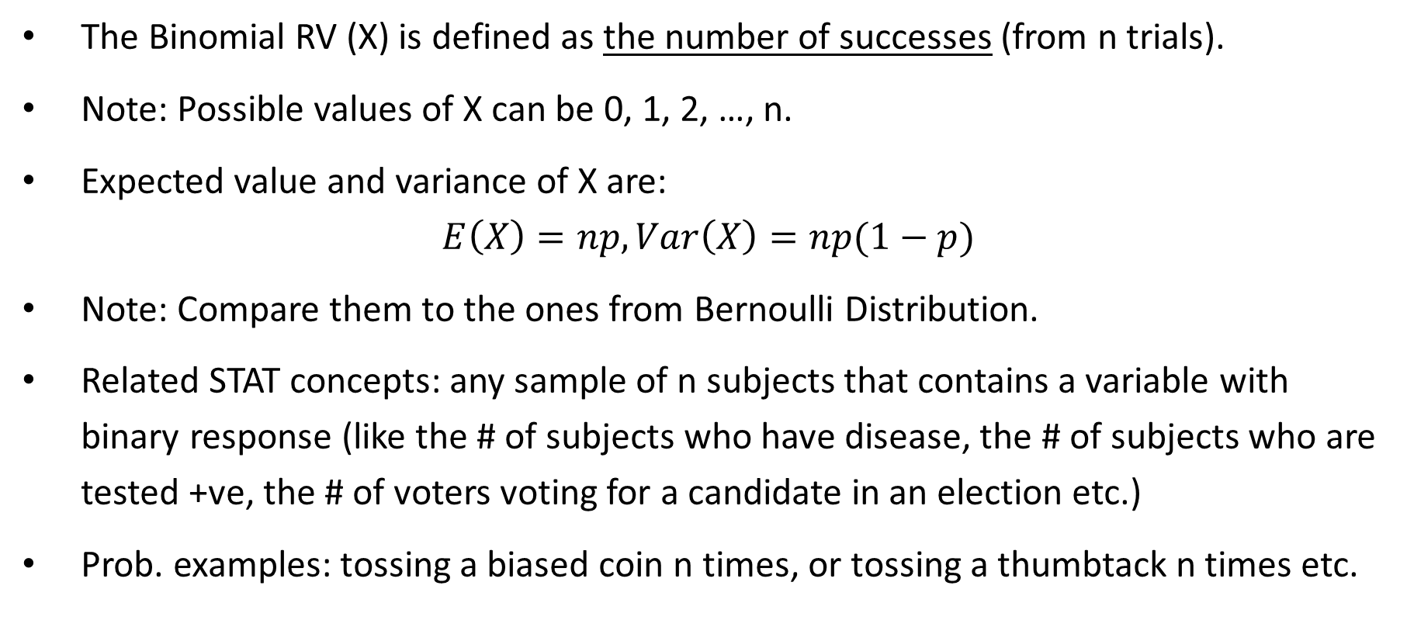
Binomial Distribution Applications
The Binomial RV (X) is defined as the number of successes (from n trials).
Note: Possible values of X can be 0, 1, 2, …, n.
Expected value and variance of X are:
$$E\left(X\right)=np, Var\left(X\right)=np(1−p)$$
Note: Compare them to the ones from Bernoulli Distribution.
Related STAT concepts: any sample of n subjects that contains a variable with binary response (like the # of subjects who have disease, the # of subjects who are tested +ve, the # of voters voting for a candidate in an election etc.)
Prob. examples: tossing a biased coin n times, or tossing a thumbtack n times etc.

Slide 14
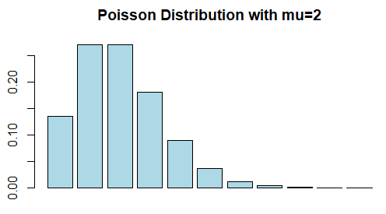
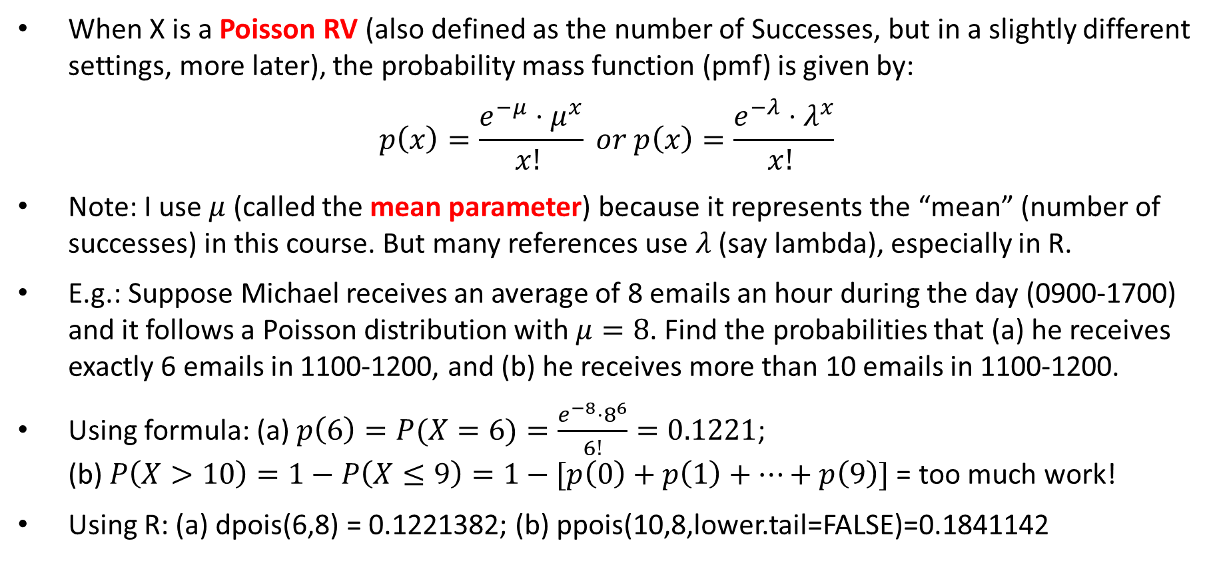
Poisson RV & Probability Calculations
When X is a Poisson RV (also defined as the number of Successes, but in a slightly different settings, more later), the probability mass function (pmf) is given by:
$$p\left(x\right)=\frac{e^{−μ}{⋅μ}^{x}}{x! } or p\left(x\right)=\frac{e^{−λ}{⋅λ}^{x}}{x! }$$
Note: I use $μ$ (called the mean parameter) because it represents the “mean” (number of successes) in this course. But many references use $λ$ (say lambda), especially in R.
E.g.: Suppose Michael receives an average of 8 emails an hour during the day (0900-1700) and it follows a Poisson distribution with $μ=8$. Find the probabilities that (a) he receives exactly 6 emails in 1100-1200, and (b) he receives more than 10 emails in 1100-1200.
Using formula: (a) $p\left(6\right)=P(X=6)=\frac{e^{−8}⋅8^{6}}{6!}=0.1221$; (b) $P\left(X>10\right)=1−P\left(X≤9\right)=1−[p\left(0\right)+p\left(1\right)+⋯+p\left(9\right)]$ = too much work!
Using R: (a) dpois(6,8) = 0.1221382; (b) ppois(10,8,lower.tail=FALSE)=0.1841142
Notes:
In (b), you could also use the following 2 ways:
1-ppois(10,8)
1-sum(dpois(0:10,8))

Slide 15
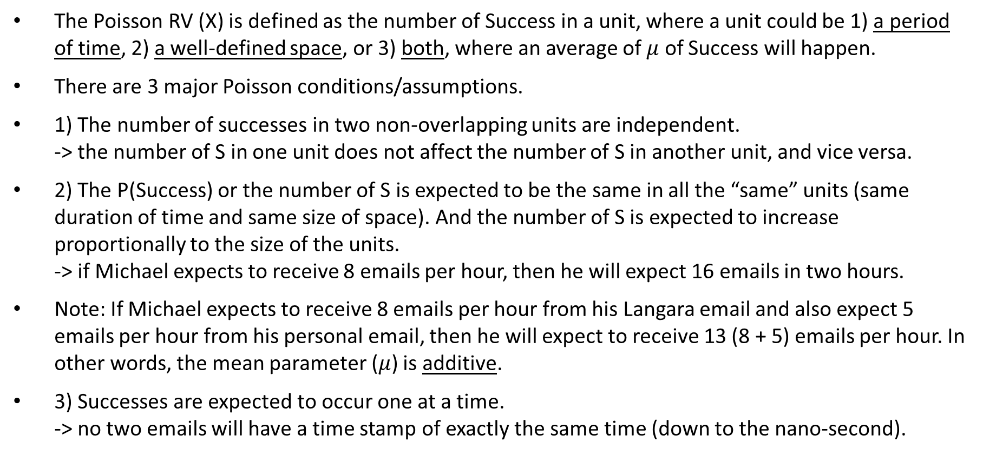
The Poisson Conditions
The Poisson RV (X) is defined as the number of Success in a unit, where a unit could be 1) a period of time, 2) a well-defined space, or 3) both, where an average of $μ$ of Success will happen.
There are 3 major Poisson conditions/assumptions.
1) The number of successes in two non-overlapping units are independent. -> the number of S in one unit does not affect the number of S in another unit, and vice versa.
2) The P(Success) or the number of S is expected to be the same in all the “same” units (same duration of time and same size of space). And the number of S is expected to increase proportionally to the size of the units. -> if Michael expects to receive 8 emails per hour, then he will expect 16 emails in two hours.
Note: If Michael expects to receive 8 emails per hour from his Langara email and also expect 5 emails per hour from his personal email, then he will expect to receive 13 (8 + 5) emails per hour. In other words, the mean parameter ($μ$) is additive.
3) Successes are expected to occur one at a time. -> no two emails will have a time stamp of exactly the same time (down to the nano-second).

Slide 16
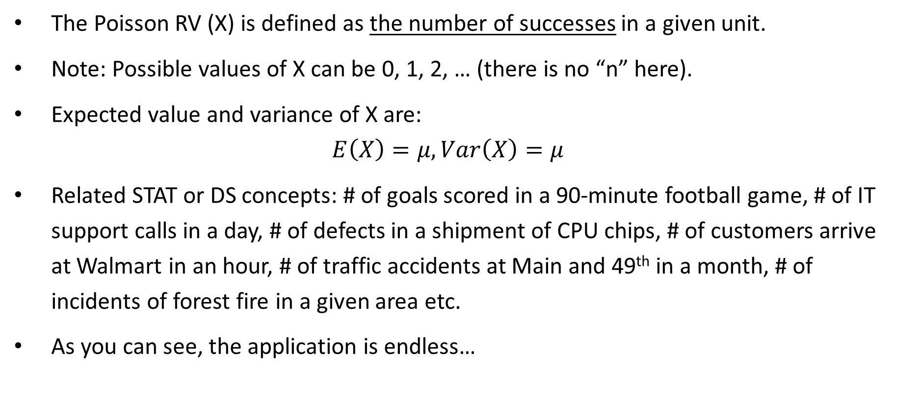
Poisson Distribution Applications
The Poisson RV (X) is defined as the number of successes in a given unit.
Note: Possible values of X can be 0, 1, 2, … (there is no “n” here).
Expected value and variance of X are:
$$E\left(X\right)=μ, Var\left(X\right)=μ$$
Related STAT or DS concepts: # of goals scored in a 90-minute football game, # of IT support calls in a day, # of defects in a shipment of CPU chips, # of customers arrive at Walmart in an hour, # of traffic accidents at Main and 49th in a month, # of incidents of forest fire in a given area etc.
As you can see, the application is endless…
Notes:
The Poisson Distribution is named after a French mathematician Simeon Poisson (https://en.wikipedia.org/wiki/Sim%C3%A9on_Denis_Poisson).
As you might know, poisson in French means fish. So, we sometimes call this a “fishy” distribution.

Slide 17
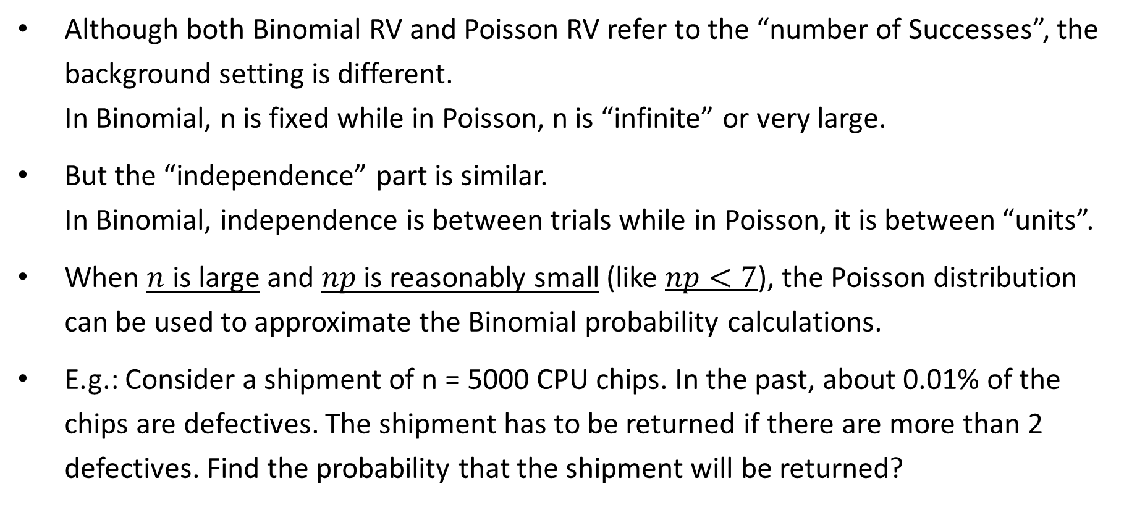
Poisson Approx. to Binomial
Although both Binomial RV and Poisson RV refer to the “number of Successes”, the background setting is different. In Binomial, n is fixed while in Poisson, n is “infinite” or very large.
But the “independence” part is similar. In Binomial, independence is between trials while in Poisson, it is between “units”.
When $n$ is large and $np$ is reasonably small (like $np<7$), the Poisson distribution can be used to approximate the Binomial probability calculations.
E.g.: Consider a shipment of n = 5000 CPU chips. In the past, about 0.01% of the chips are defectives. The shipment has to be returned if there are more than 2 defectives. Find the probability that the shipment will be returned?
Notes:
Binomial:
n = 5000, p = 0.0001
-> We want P(X > 2) = 1 – P(X <= 2).
Using R, both of the following gives 0.01438199
1-sum(dbinom(0:2,5000,0.0001))
1-pbinom(2,5000,0.0001)
pbinom(2,5000,0.0001,FALSE)
Poisson:
mu = np = 5000*0.0001 = 0.5, this is well below the condition of “np < 7”
-> We want P(X > 2) = 1 – P(X <= 2).
Using R, both of the following gives 0.01438768
1-sum(dpois(0:2,0.5))
1-ppois(2,0.5)
ppois(2,0.5,FALSE)

Slide 18
Other Notable Distributions
Geometric Distributions (more DS applications):
The most common definition of a geometric RV is the number of Failures before getting the first Successes.
Examples: If Success is defined properly, it has many interesting uses (like Success = detecting the first spam mail after many Failures = non-spam email; Success = a share of a social media post after many Failures = no action taken etc.)
Hypergeometric Distributions (more STAT applications):
The most common use is to find the probability in stratified random sampling method.
Example: Suppose 10 Board Members (3 with Accounting background and other 7 don’t). A subcommittee of 3 Board Members (with at least one Accounting member) is drawn. How likely can this be achieved?

Slide 19

Any Questions?

